Slide 1
Image classification
Rafał Klinowski, Jakub Cisowski
Biologically inspired artificial intelligence, sem. 6

Slide 2
What is image classification?
Categorizing images
Tries to answer the question: „What is in the picture?”
Based on pixels or vectors within an image
Tries to recognize patterns within an image to make predictions
We explore „single-label classification” which only assigns one value to an image

Slide 3

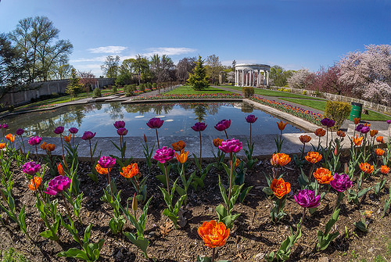
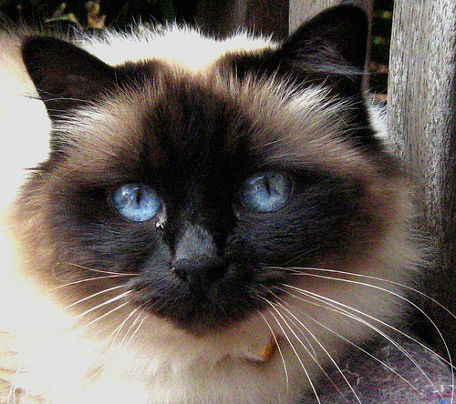
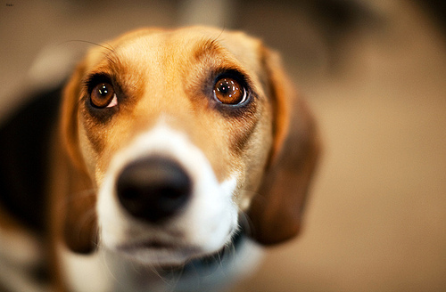
Roses
Tulips
Cat
Dog

Slide 4
Real life examples of image recognition
Medicine – eg. to help doctors detect abnormalities such as cancer
Self-driving cars
Face ID and other facial recognition systems
Retail – eg. the ability to try on a piece of clothing online

Slide 5
Our project

Slide 6
Distinction between cat and dog breeds
One step further than just saying „dog or cat”
Input: an image
Output: name of dog or cat breed as well as certainty (in %)

Slide 7
84% Birman
98% Beagle

Slide 8
Dataset used for training
Courtesy of The University of Oxford
JPG image files
37 cat or dog races
About 200 images for each breed
Over 7390 images in total
Various sizes (have to be standardized before training)

Slide 9
Description of technology
Programming language: Python
TensorFlow – used to create, train, save and load model
Keras – used to simplify data loading and dividing into different categories
MatPlotLib – used to generate plots describing model performance, accuracy
Algorithm:
Divide images into groups based on race
Calculate minimum, maximum and average image size (used when creating model)
Load data, split into two groups: training, validation
Create, compile, train and evaluate model
Save model as a group of files

Slide 11
What is a model?
Program, consists of code, metrics, pre-calculated values, etc. – often hundreds of thousands of lines
Often split into multiple files when saved
Trained to a set of data
Can be „fed” data it hasn’t seen before to make predictions
Ideally should perfectly distinguish images that were used for training
Most often evaluated using:
Accuracy (overall percentage of correct predictions)
Loss (value of cost function for validation data)
Confusion Matrix (tracks correct and incorrect predictions divided into classes)

Slide 12
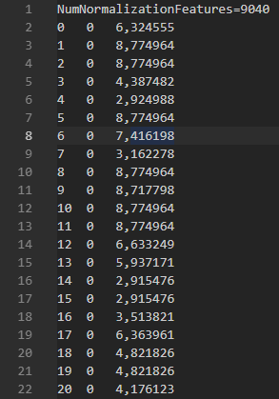
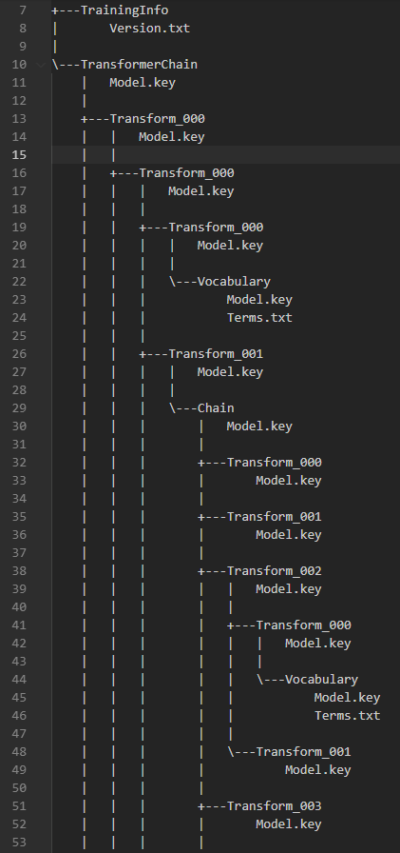
Example model file
Example model tree

Slide 13
Sources
https://www.kaggle.com/datasets/zippyz/cats-and-dogs-breeds-classification-oxford-dataset
https://www.tensorflow.org/
https://docs.python.org/3/reference/

Slide 14
The end

